Slide 1

Fundamentals of Artificial Intelligence
Farian S. L Ishengoma

Slide 2
Learning
Forms of learning
Learning concepts, methods, and paradigms
Supervised learning
Unsupervised learning
Statistical learning
Artificial Neural network
Ensemble learning
Adaptive learning
Reinforcement learning

Slide 3

Forms of learning
There are three forms of learning
Behavioral Learning:
Behavioral learning refers to the process of learning by association, which occurs when a person learns to associate a particular stimulus with a certain response.
The most common forms of behavioral learning are classical conditioning and operant conditioning.
Cognitive Learning:
Cognitive learning involves the acquisition of knowledge, skills, and understanding through thinking, reasoning, and problem-solving.
Examples of cognitive learning include concept learning, insight learning, and problem-solving.
Social Learning:
Social learning involves learning through observation, imitation, and social interaction.
It occurs when individuals learn from the behaviors and actions of others in their environment.
Social learning can occur through modeling, where individuals learn by observing and imitating the behavior of others.
It can also occur through vicarious learning, where individuals learn from the consequences of other people's behavior.

Slide 4
Common terms used in Ml
Dataset:
A dataset is a collection of data used for training, testing, or evaluating a machine learning model.
Feature:
A feature is an individually measurable property or characteristic of an observed event that is used as input by an algorithm for machine learning.
For example, the age, gender, and education level of a person may be features used to predict their income.
Label:
A label is the output or target variable that the machine learning algorithm tries to predict, such as a category or numerical value.
For example, in a spam detection model, the label may be "spam" or "not spam."
Training:
Training is the process of using a dataset to teach a machine learning model to make predictions.

Slide 5
Cont.
Testing:
Testing is the process of evaluating the performance of a machine learning model on a dataset that it has not seen before.
This is done to estimate how well the model will perform on new, unseen data.
Validation:
Validation is the process of evaluating the performance of a machine learning model on a dataset that is separate from both the training and testing data.
Validation is used to assess whether the model is overfitting or underfitting.
Overfitting:
Overfitting occurs when a machine learning model is trained to fit the training data too closely and performs poorly on new, unseen data.
Underfitting:
Underfitting occurs when a machine learning model is not complex enough to capture the relationships between the input features and the output labels, and it performs poorly on both the training and testing data.

Slide 6
Cont.
Model:
A model is a representation of the relationships between the input features and the output labels learned from the training data.
The model is used to make predictions on new, unseen data.
Algorithm:
An algorithm is a set of rules or procedures used to solve a problem.
In machine learning, algorithms are used to learn from data and make predictions.
Hyperparameters:
Hyperparameters are settings or configurations of a machine learning algorithm that are set before training.
These include parameters such as the learning rate, regularization, and number of hidden layers in a neural network.

Slide 7
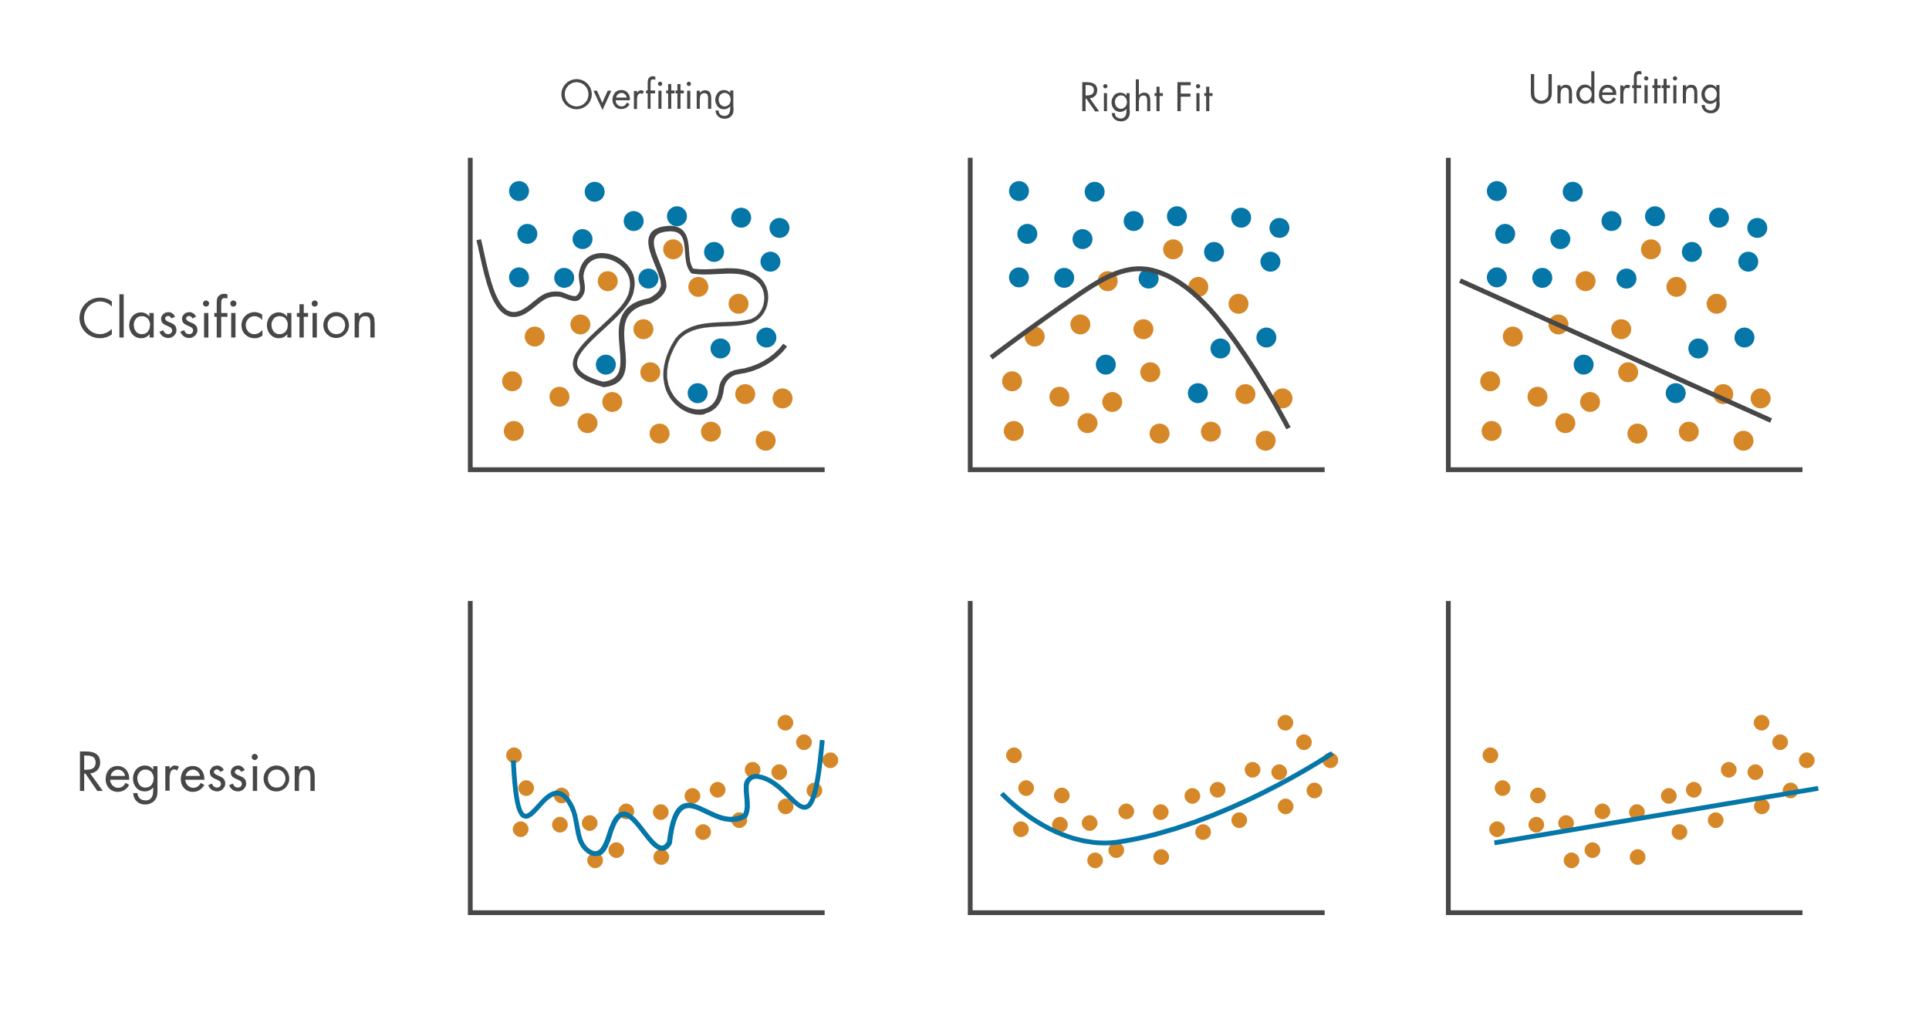
Cont.
Relationship between:
Overfitting
Underfitting

Slide 8
Learning concepts, methods, and paradigms
The learning concepts can be categorized into
Rote learning
Learning from observation
Learning from agents
Inductive learning
Decision tree learning
Unsupervised learning
Supervised learning
Statistical learning
Ensemble learning
Adaptive learning
Reinforcement learning

Slide 9
Rote learning
Rote learning is a type of learning where information is learned through repetition, without necessarily understanding the underlying concepts or principles.
It involves memorizing information through repetition, often through trainings or memorization techniques.
This type of learning is often used in the early stages of education, such as learning the alphabet, multiplication tables, or simple vocabulary words.
In rote learning, the focus is on memorizing the information rather than understanding the concepts or principles behind it.
One of the limitations of rote learning is that it can lead to a lack of creativity and innovation.
When individuals are trained to memorize information without understanding the underlying concepts, they may struggle to apply that information to new and novel situations.
Additionally, rote learning can lead to a lack of engagement and motivation, as it can become repetitive and boring over time.

Slide 10
Learning from observation
Learning from observation
Learning from agents
Inductive learning
Decision tree learning

Slide 11
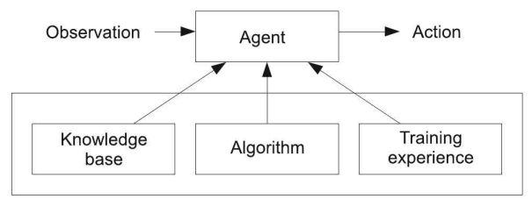
Learning from agents
Learning from agents in ML refers to the process of training models to learn from interactions with other intelligent agents, such as robots or other AI systems.
This type of learning is often used in reinforcement learning, where an agent learns to take actions in an environment to maximize a reward signal.

Slide 12
Real life example
Training a self-driving car to learn from the behavior of other drivers on the road. Self-driving cars use various sensors and cameras to detect and analyze the environment around them, including other vehicles, pedestrians, and traffic signals.
Reinforcement learning can be used to train a self-driving car to learn from the behavior of other drivers on the road. For example, the car may observe that some drivers tend to slow down before making a turn, while others tend to speed up. It can then use this information to adjust its own driving behavior to be more similar to successful drivers.
To do this, we first define the game environment, which consists of the road network and the rules of the road. We then define a reward function that assigns a numerical reward signal to each state of the game, based on the safety and efficiency of the car's driving behavior

Slide 13
Inductive learning
Inductive learning is a type of supervised learning in machine learning where a model is trained to generalize from a set of labeled examples to predict the labels of new, unseen examples.
This is done by identifying patterns in the input data and mapping them to the corresponding output labels.
A classic example of inductive learning is training a model to classify images of handwritten digits, such as the MNIST dataset.
In this task, the input is an image of a handwritten digit, and the output is the corresponding digit label (0-9).
To train the model, we first split the dataset into a training set and a test set.
We use the training set to train the model to recognize patterns in the input data and predict the corresponding output label.

Slide 14
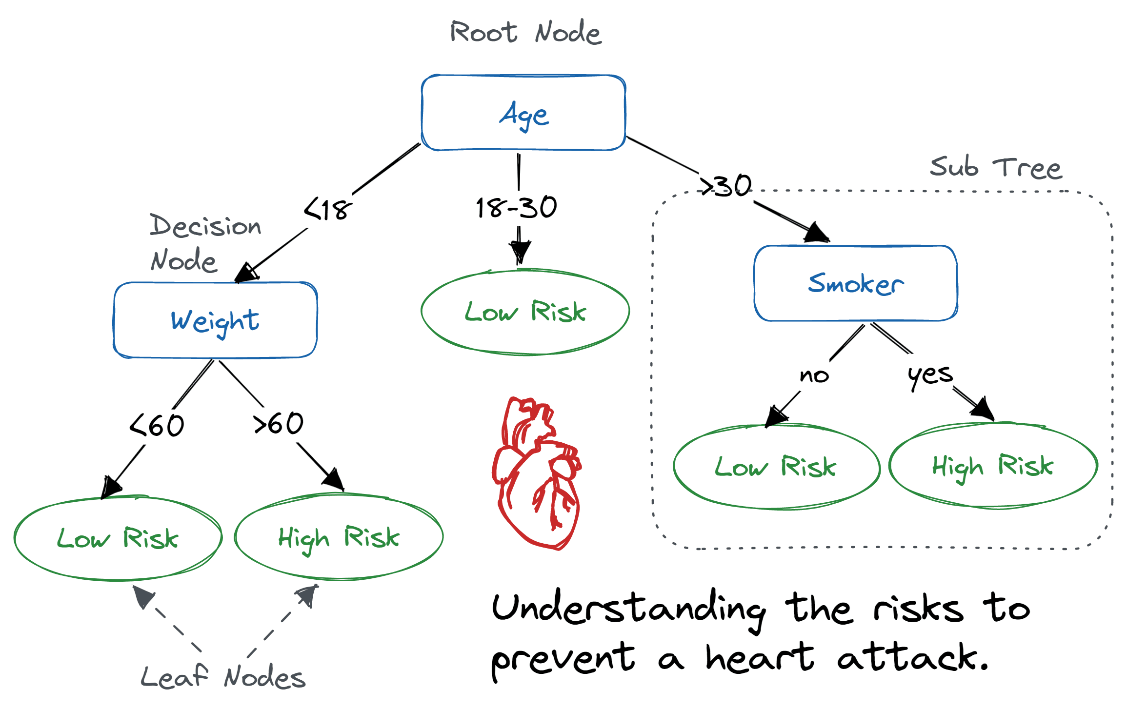
Decision tree learning
Decision tree learning is a popular algorithm used for classification and regression tasks in machine learning.
The goal of the algorithm is to build a tree-like model that can be used to make predictions based on a set of input features.

Slide 15
Supervised learning
Supervised learning is a type of machine learning where a model is trained using labeled examples to predict the output for new, unseen data.
In supervised learning, the input data and the corresponding output labels are provided to the model during the training phase.
Supervised learning is a powerful technique that has many applications in various domains such as computer vision, speech recognition, and natural language processing.
It allows us to train models to make accurate predictions on new, unseen data by learning from labeled examples in the training data.

Slide 16
Real life example
Suppose we want to train a model to recognize handwritten digits.
We have a dataset of labeled images where each image is a handwritten digit (0 to 9) and the corresponding label is the digit it represents.
In supervised learning, we would use this labeled dataset to train the model. The input features are the pixels of the image, and the output label is the corresponding digit.
We would split the dataset into a training set and a test set and use the training set to train the model using a technique such as a neural network.
During the training phase, the model learns to map the pixel values to the corresponding digit using the labeled training data.
For example, the model might learn that a certain combination of pixels corresponds to the digit "3", while another combination corresponds to the digit "7".
The model adjusts its parameters based on the training data and the objective function (such as cross-entropy loss) to minimize the error between the predicted and actual labels.
Once the model is trained, we can use it to make predictions on new, unseen images of handwritten digits.
We provide the image as input to the model, and the model predicts the corresponding digit.
For example, we can use the trained model to recognize the digits in a scanned document.

Slide 17
Unsupervised learning
Unsupervised learning is a type of machine learning where the model is trained on unlabeled data without any specific output label.
The objective of unsupervised learning is to find patterns or structure in the data that can be used to gain insights or make predictions.
Unsupervised learning also has many other applications, such as dimensionality reduction, anomaly detection, and generative modeling.
For example, in dimensionality reduction, unsupervised learning can be used to reduce the number of features in a dataset while retaining most of the relevant information.
In anomaly detection, unsupervised learning can be used to identify rare or abnormal instances in a dataset.
In generative modeling, unsupervised learning can be used to learn the underlying distribution of the data and generate new instances that resemble the original data.

Slide 18
example
An example of unsupervised learning is clustering.
Suppose we have a dataset of customer transactions that include features such as purchase amount, location, and time of day, but without any labels indicating which customers are similar or different.
In unsupervised learning, we would use this dataset to group similar customers together into clusters.
To perform clustering, we use an unsupervised learning algorithm such as k-means clustering.
This algorithm starts by randomly selecting k centroids (where k is the number of clusters we want to form) and then assigns each data point to the nearest centroid based on its distance.
The algorithm then calculates the new centroids based on the mean of the data points in each cluster and repeats the process until the centroids no longer move significantly.
Once the clustering algorithm has converged, we can examine the clusters to gain insights about the customer behavior.
For example, we might find that one cluster of customers tends to make high-value purchases at a specific time of day, while another cluster tends to make smaller purchases at a different time of day.
We can use these insights to target different customer segments with tailored marketing campaigns.

Slide 19

Statistical learning
Statistical learning is a type of machine learning that uses statistical methods to analyze and model complex datasets.
The objective of statistical learning is to make accurate predictions or uncover underlying relationships in the data.
Statistical learning also includes other techniques such as logistic regression, time series analysis, Bayesian inference, principal component analysis, cluster analysis, and support vector machines.
These techniques can be used to solve a wide range of problems in various domains such as finance, healthcare, social sciences, recognition, natural language processing, and recommendation systems.

Slide 20

Artificial Neural network
An artificial neural network (ANN) is a type of machine learning model that is inspired by the structure and function of the human brain.
It is composed of interconnected processing nodes, called neurons, that work together to perform a specific task.
An ANN typically consists of three types of layers: an input layer, one or more hidden layers, and an output layer.
Each neuron in the input layer represents a feature of the input data, while each neuron in the output layer represents a possible output of the model.
The hidden layers are composed of neurons that apply nonlinear transformations to the input data, allowing the network to capture complex relationships between the input and output variables.

Slide 21
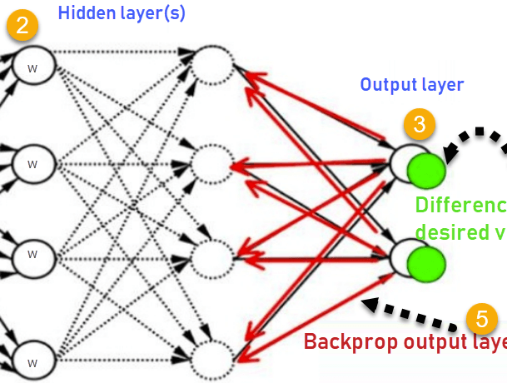
Cont.
The neurons in an ANN are connected by weighted edges, which represent the strength of the connection between two neurons.
During training, the weights of the connections are adjusted based on the difference between the predicted output of the network and the true output, using a technique called backpropagation.
Backpropagation involves propagating the error from the output layer back through the network and adjusting the weights of the connections to minimize the error.

Slide 22
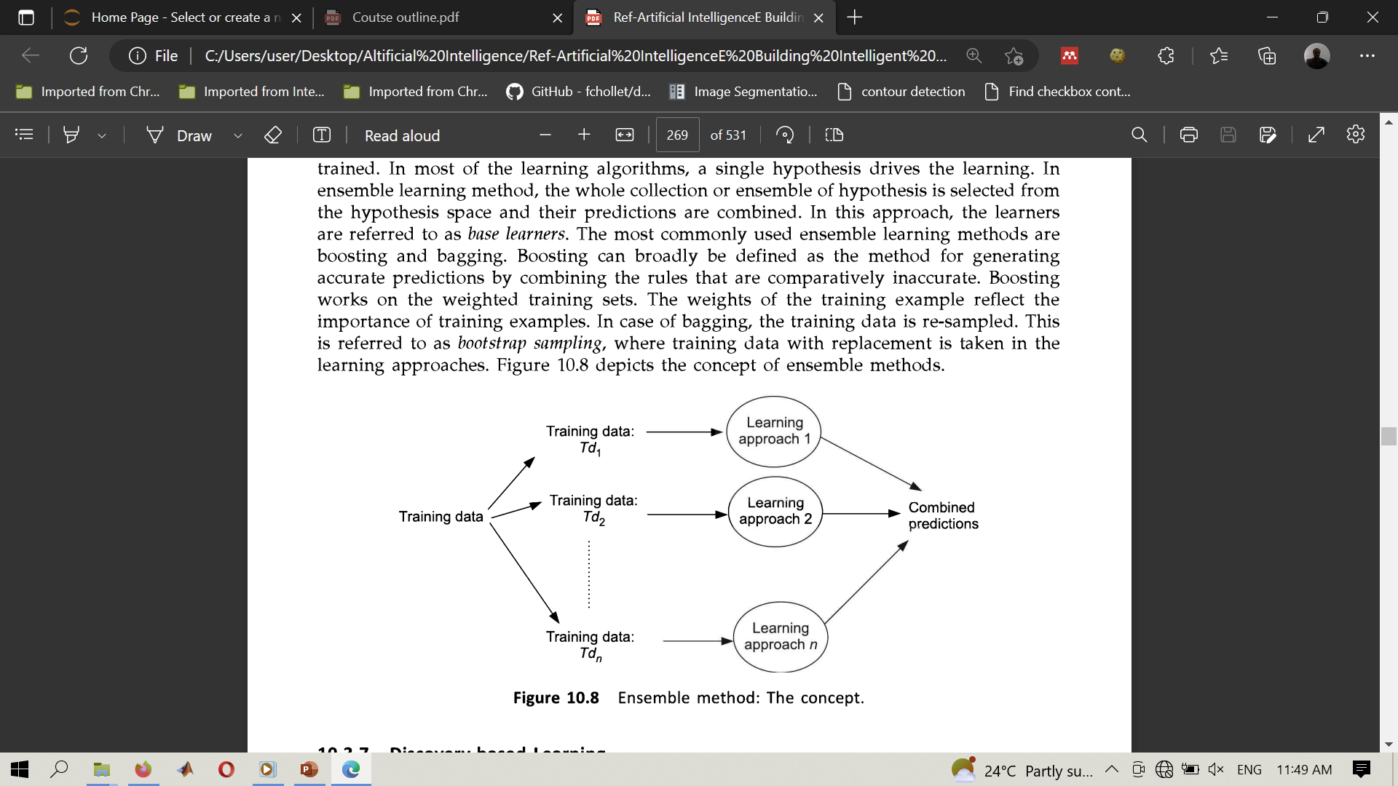
Ensemble learning
Ensemble learning is a technique in machine learning where multiple models are combined to improve the overall performance and accuracy of the system.
The idea behind ensemble learning is that when multiple models are combined, they can compensate for each other's weaknesses and produce more accurate predictions.

Slide 23
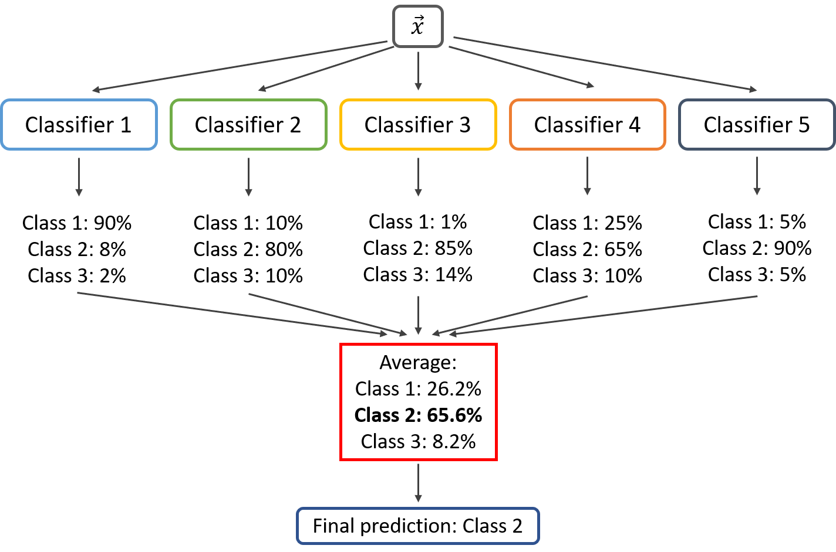
example
Suppose you are attempting to predict whether a customer will leave your company using a classification problem.
You have three different algorithms: logistic regression, decision tree, and random forest, each of which gives an accuracy of 75%, 80%, and 85%, respectively.
To use ensemble learning, you can combine these models to create a more accurate system. There are two common ways to combine models:
Voting:
In this approach, the predictions from each model are combined, and the final prediction is based on the majority vote.
For example, if two models predict that the customer will churn, and one model predicts that the customer will not churn, the final prediction will be that the customer will churn.

Slide 24
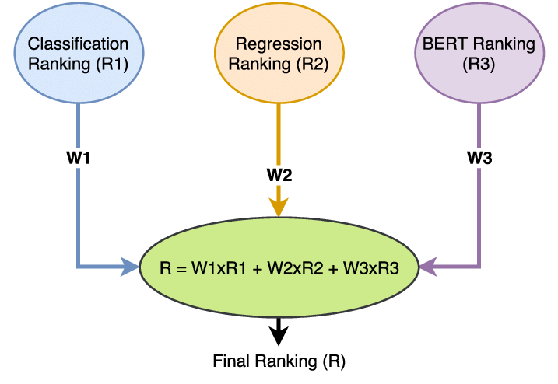
Cont.
Weighted average:
In this approach, the predictions from each model are combined, and the final prediction is based on a weighted average.
The weights assigned to each model can be based on their individual performance.
For example, if the logistic regression, decision tree, and random forest models have accuracies of 75%, 80%, and 85%, respectively, you can assign weights of 0.25, 0.3, and 0.45 to each model, respectively.
The final prediction is then calculated by taking the weighted average of the three models.

Slide 25

Adaptive learning
Adaptive learning
is a type of machine learning where the model adjusts its parameters based on feedback from the system's performance. Or
Is a type of machine learning technique where the model is trained to adapt to changes in the input data over time
The goal of adaptive learning is to improve the model's accuracy over time by adjusting its parameters based on the feedback it receives.
In adaptive learning, the model is updated continuously based on feedback from the system's performance.
This feedback can come from various sources, such as user feedback, sensor data, or performance metrics.
The model's parameters are adjusted based on this feedback to improve its accuracy on the task at hand.
A common example of adaptive learning in ML is transfer learning.

Slide 26
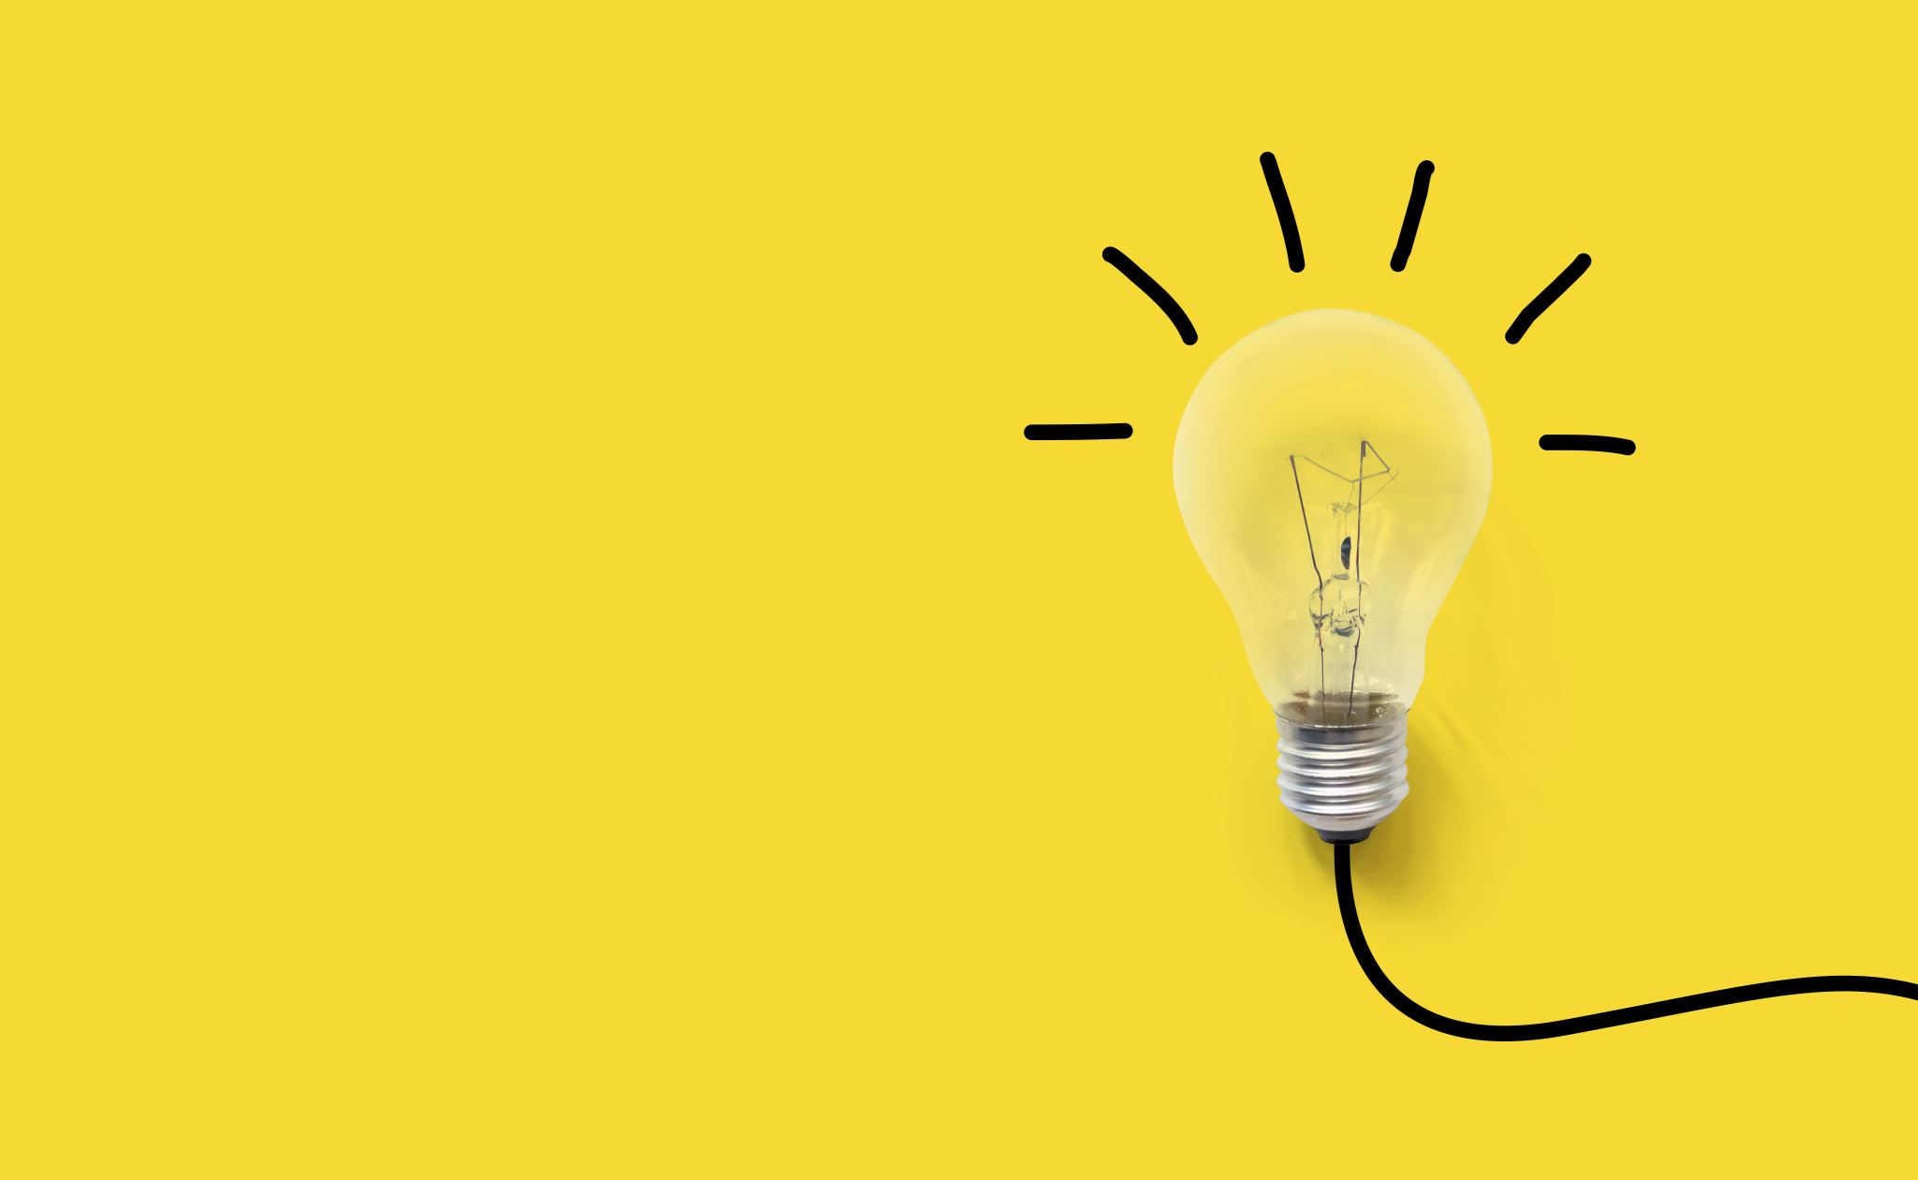
transfer learning
In transfer learning, a model is first trained on a large dataset for a specific task, such as image recognition.
Once the model is trained, it can be used as a starting point for training on a new, related task, such as identifying different species of flowers.
Rather than starting from scratch, the model uses the knowledge it gained from the first task to improve its performance on the second task.
For example, let's say we want to train a model to recognize different types of flowers.
We start by training a deep convolutional neural network (CNN) on a large dataset of images of everyday objects, such as the ImageNet dataset.
Once the model is trained, we can use transfer learning to adapt it to our specific task of flower recognition.
To do this, we can replace the final layer of the CNN with a new layer that has a different number of outputs corresponding to the different types of flowers we want to recognize.
We then fine-tune the model on a smaller dataset of flower images, allowing it to adapt to the specific features of the flower images.
The advantage of using transfer learning is that it allows us to train a highly accurate model on a new task with less training data and less training time than if we were to start from scratch.
The model has already learned to recognize basic features such as lines, shapes, and textures from the first task, so it can focus on learning the specific features of the flower images in the second task.
This makes the training process faster and more efficient, while still producing accurate results on the new task.

Slide 27
Reinforcement learning
Reinforcement learning is a type of machine learning that involves an agent learning through trial and error to maximize a reward signal in an environment.
The agent learns by interacting with the environment and receiving feedback in the form of rewards or punishments.
An example of reinforcement learning is training an autonomous vehicle to navigate a city.
The vehicle is the agent, and the environment is the city, which includes roads, traffic lights, other vehicles, and pedestrians. The objective is to reach the destination safely and efficiently while obeying traffic laws.
The agent uses reinforcement learning to make decisions on how to navigate the city.
At each time step, it observes the current state of the environment (e.g., the position of the vehicle, the location of other vehicles, the color of the traffic light) and takes an action (e.g., accelerate, brake, turn left, turn right).

Slide 28
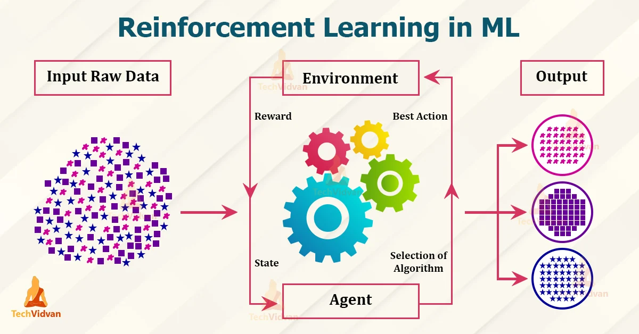
Cont.
The action leads to a new state, and the agent receives a reward signal based on how well it performs the task (e.g., reaching the destination on time, avoiding collisions, minimizing fuel consumption).
The agent then uses this feedback to adjust its decision-making process and improve its performance over time.
To train the agent using reinforcement learning, we use a technique called Q-learning. Q-learning involves creating a table or function that estimates the expected cumulative reward for each action taken in a given state.
The agent uses this table to choose the action that maximizes its expected cumulative reward. As the agent interacts with the environment and receives feedback, the Q-values are updated to reflect the new information.

Slide 29



end

